Slide 1
Organisasi dan Arsitektur Komputer
Semester Gasal 2020/2021
Rismiyati B.Eng, M.Cs

Slide 2
Kontrak Kuliah
14 Pertemuan
3 Sks
Bobot :
UTS : 35
UAS : 35
Tugas, keaktifan, dan lain lain :30
Platform perkuliahan
Teams
Kulon

Slide 3
Materi
Refer ke RPS
Rules:
Keterlambatan
On cam ?
Mekanisme absen
Mekanisme perkuliahan

Slide 4

Organisasi dan Arsitektur Komputer
Semester Gasal 2020/2021
Rismiyati B.Eng, M.Cs

Slide 5
Pengenalan Organisasi dan Arsitektur Komputer
Konsep Dasar
Organisasi Vs Arsitektur
Fungsi Vs Struktur
Evolusi computer
Isu performa

Slide 6
Konsep dasar Organisasi dan arsitektur komputer
Computer architecture refers to those attributes of a system visible to a programmer or, put another way, those attributes that have a direct impact on the logical execution of a program.
Sering direfer sebagai ISA
instruction set architecture (ISA): defines instruction formats, instruction opcodes, registers, instruction and data memory; the effect of executed instructions on the registers and memory; and an algorithm for controlling instruction execution

Slide 7
Konsep dasar Organisasi dan arsitektur komputer
Computer organization refers to the operational units and their interconnections
Examples of architectural attributes include the instruction set, the number of bits used to represent various data types (e.g., numbers, characters), I/O mechanisms, and techniques for addressing memory that realize the architectural specifications
Organizational attributes include those hardware details transparent to the programmer, such as control signals; interfaces between the computer and peripherals; and the memory technology used

Slide 8
Contoh perbedaan Organisasi dan Arsitektur Komputer
whether a computer will have a multiply instruction : issu arsitektur
whether that instruction will be implemented by a special multiply unit or by a mechanism that makes repeated use of the add unit of the system : organizational issue

Slide 9
Fungsi dan Struktur Komputer
Structure: The way in which the components are interrelated.
Function: The operation of each individual component as part of the structure.

Slide 10
Fungsi Komputer
4 fungsi dasar computer
Data processing
Data storage
Data movement
The computer’s operating environment consists of devices that serve as either sources or destinations of data.
When data are received from or delivered to a device that is directly connected to the computer, the process is known as input– output (I/O), and the device is referred to as a peripheral.
When data are moved over longer distances, to or from a remote device, the process is known as data communications.
Control
control unit manages the computer’s resources and orchestrates the performance of its functional parts in response to instructions.

Slide 11
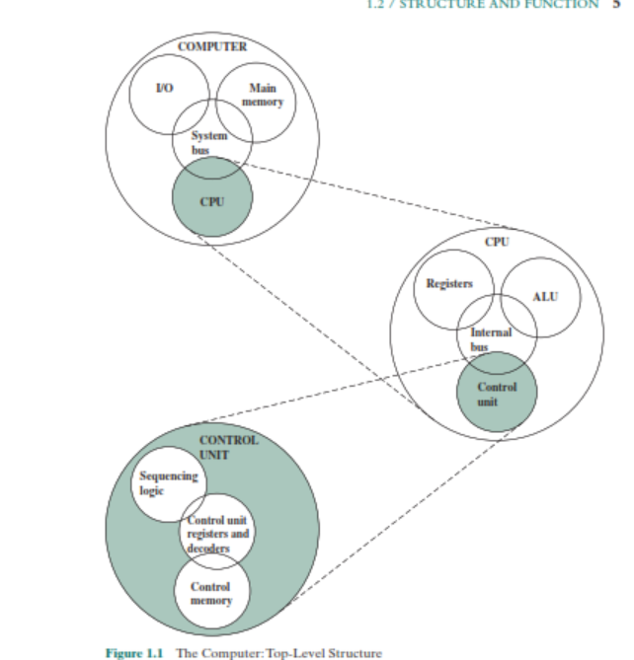
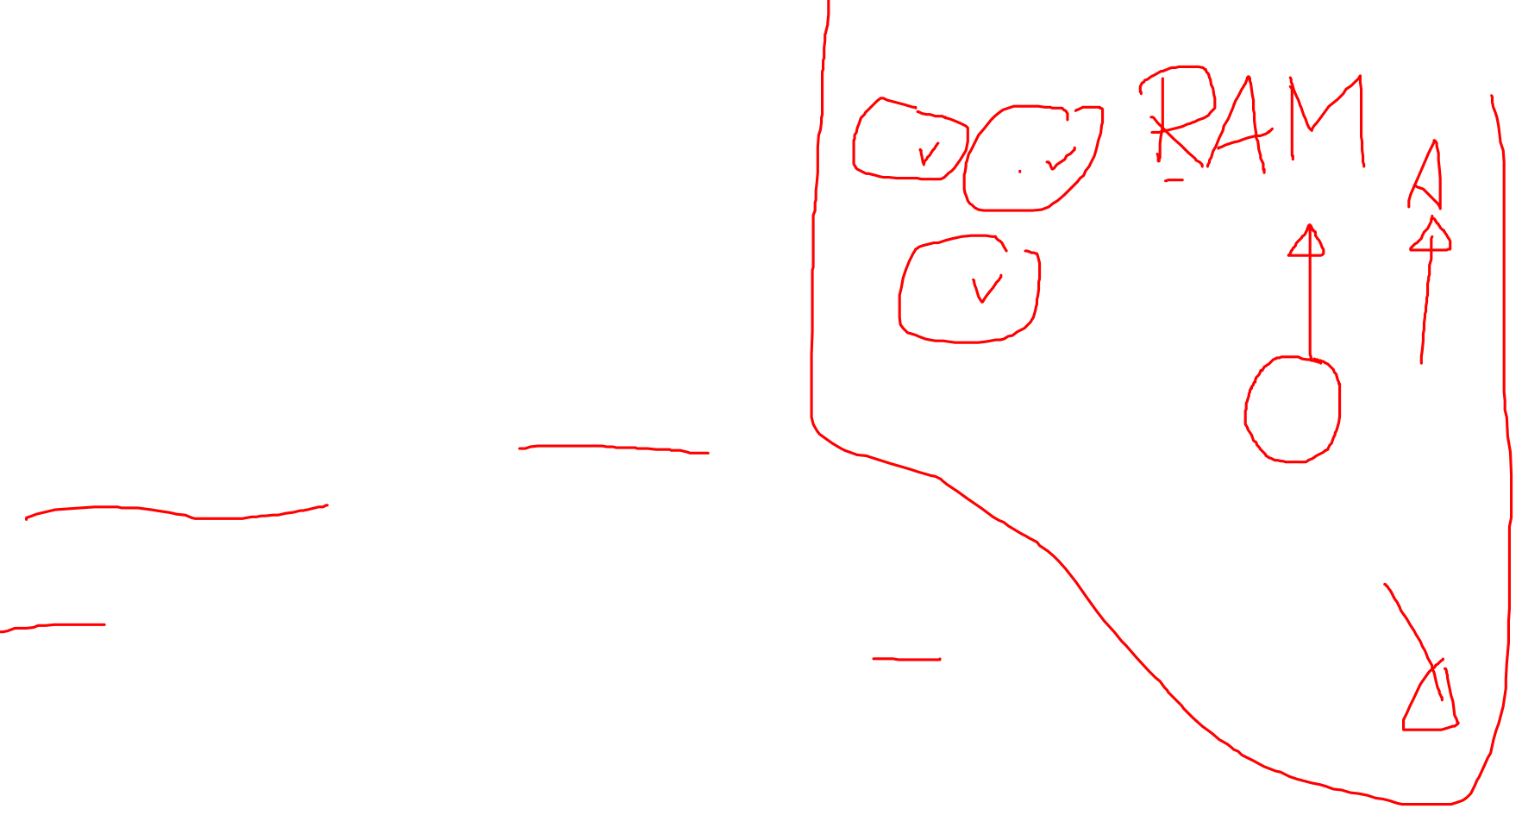
Struktur Komputer
CPU
Controls the operation of the computer and performs its data processing functions; often simply referred to as processor
Main Memory:
Stores data
IO
I/O: Moves data between the computer and its external environment
Sistem Interconnection/ bus

Slide 12

CPU
Control unit: Controls the operation of the CPU and hence the computer.
Arithmetic and logic unit (ALU): Performs the computer’s data processing functions.
Registers: Provides storage internal to the CPU.
CPU interconnection: Some mechanism that provides for communication among the control unit, ALU, and registers.

Slide 13
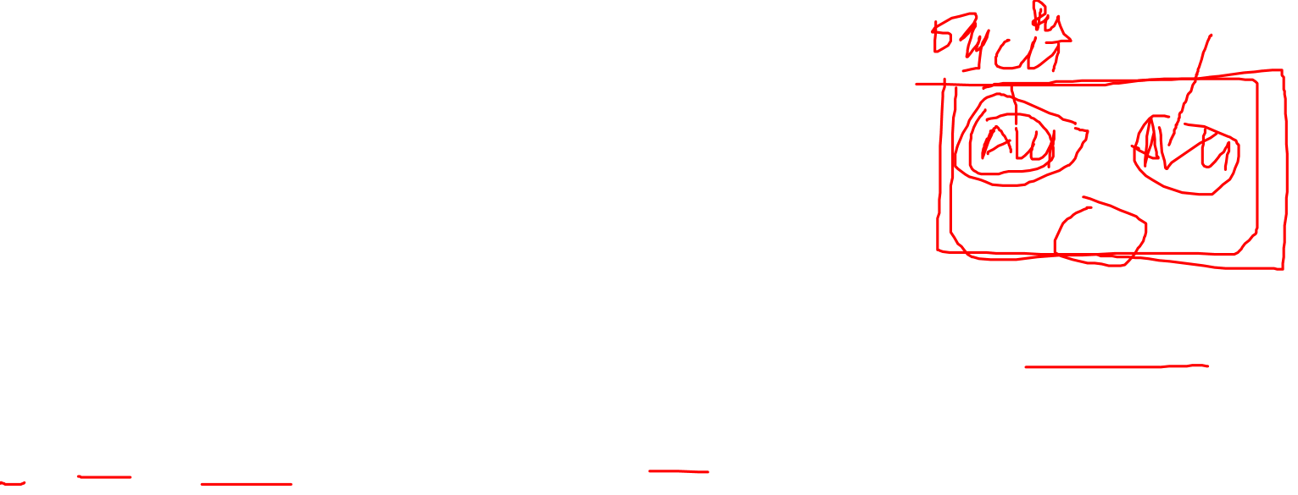
Multicore Computer Structure
Computers generally have multiple processors
these processors all reside on a single chip, the term multicore computer is used, and each processing unit (consisting of a control unit, ALU, registers, and perhaps cache) is called a core
Central processing unit (CPU) Vs Core Vs Processor

Slide 14
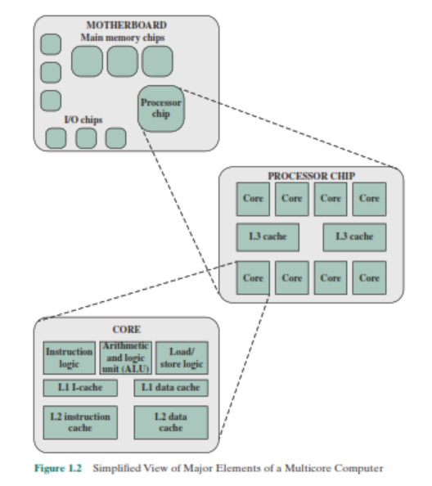

The main printed circuit board in a computer is called a system board or motherboard, while smaller ones that plug into the slots in the main board are called expansion boards.
The most prominent elements on the motherboard are the chips.
A chip is a single piece of semiconducting material, typically silicon, upon which electronic circuits and logic gates are fabricated. The resulting product is referred to as an integrated circuit.

Slide 15
fetching instructions, and decoding each instruction to determine the instruction operation and the
memory locations of any operands.

Slide 16
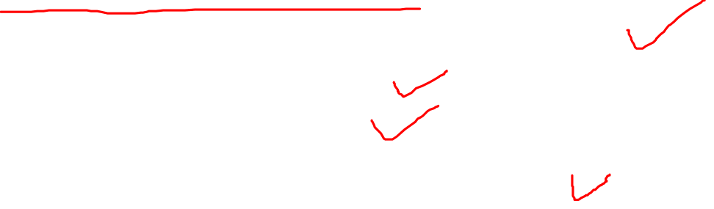
Motherboard contains
a slot or socket for the processor chip
slots for memory chips
I/O controller chips
other key computer components

Slide 17
Penugasan
Carilah gambar yang dapat menjelaskan komponen-komponen yang ada dalam motherboard
Jelaskan gambar tersebut dengan detail (masing-masing komponen dari motherboard)

Slide 18
Sejarah computer

Slide 19
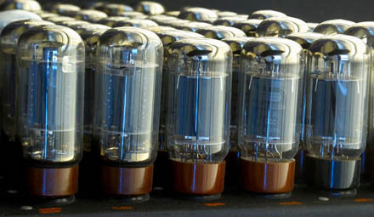
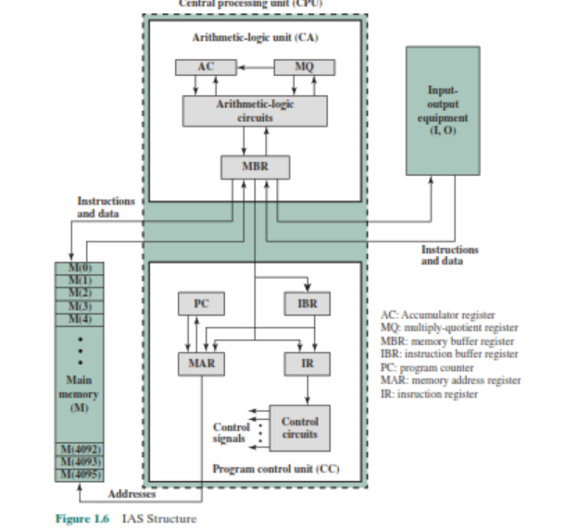
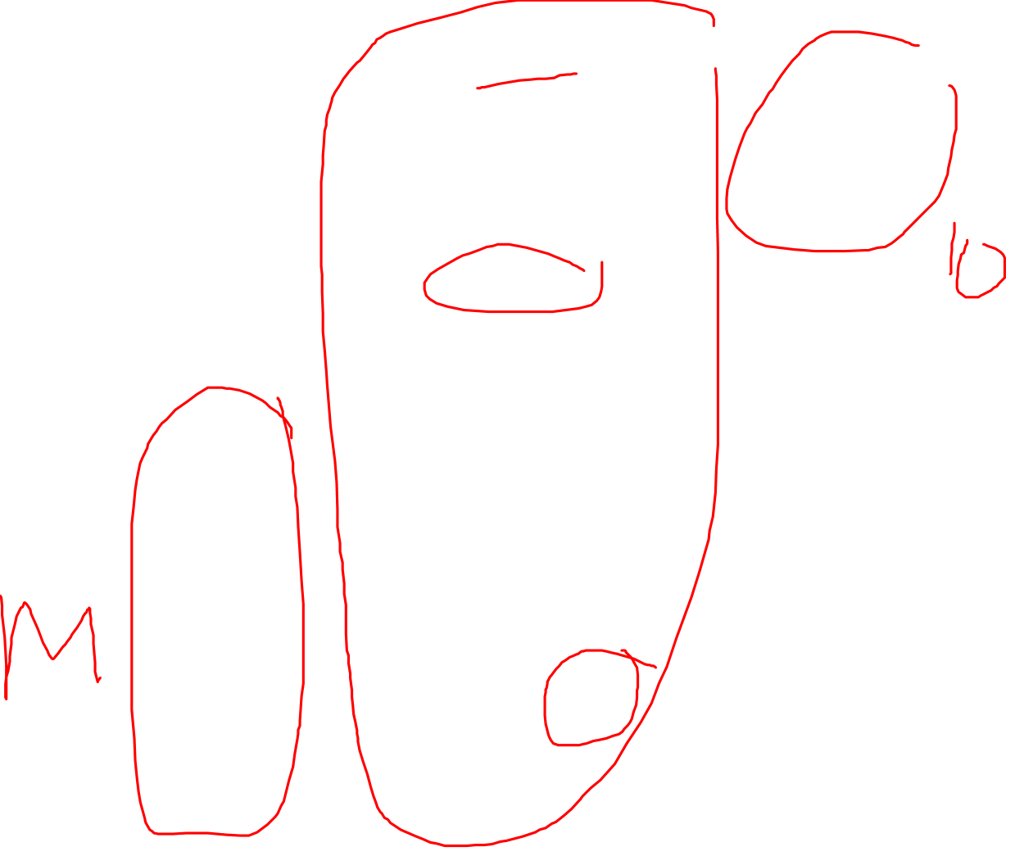
The First Generation: Vacuum Tubes
IAS computer
the stored- program concept -> John von Neumann.
prototype of all subsequent general- purpose computers

Slide 20
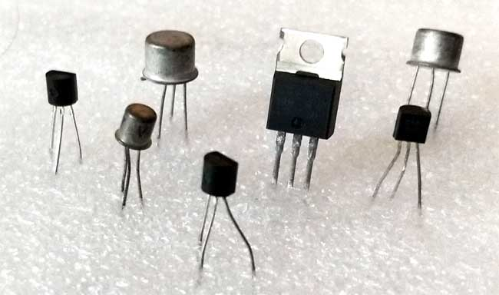
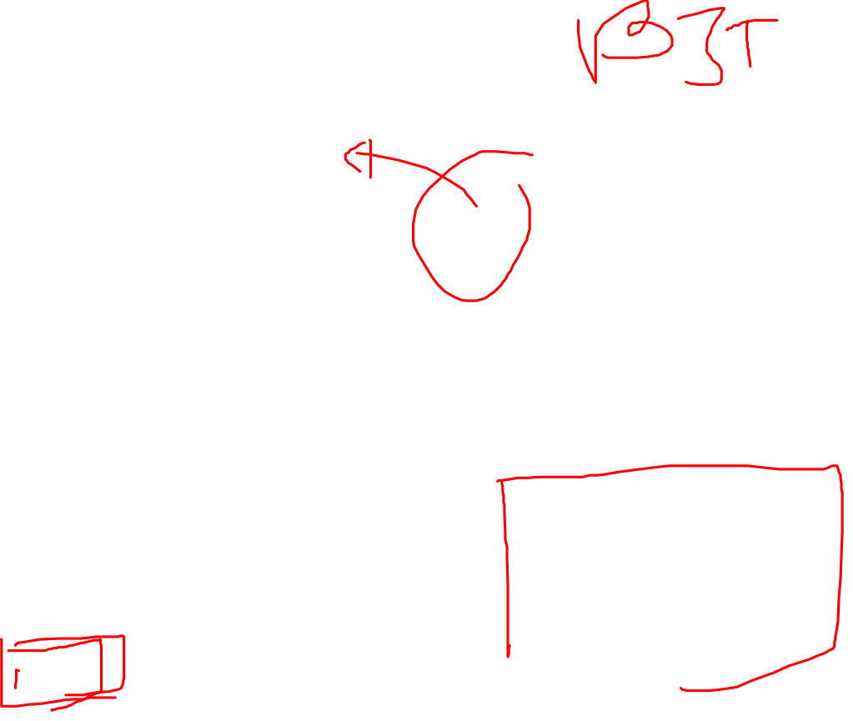
The Second Generation: Transistors
replacement of the vacuum tube by the transistor. The transistor, which is smaller, cheaper, and generates less heat than a vacuum tube, can be used in the same way as a vacuum tube To construct computers.
Unlike the vacuum tube, which requires wires, metal plates, a glass capsule, and a vacuum, the transistor is a solid- state device, made from silicon.

Slide 21
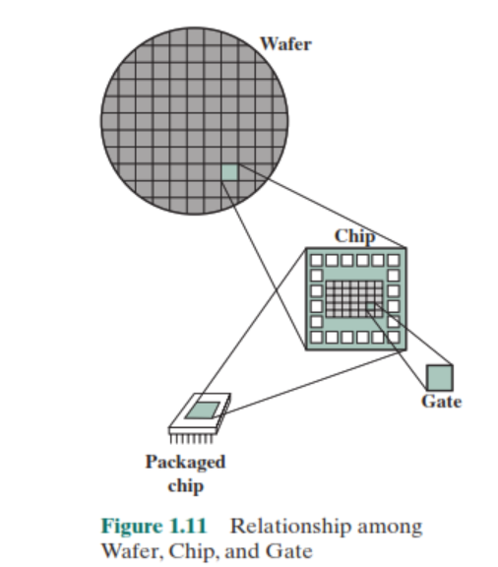
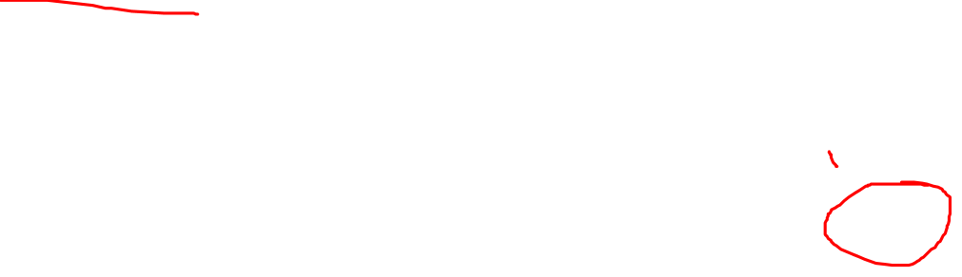
The Third Generation: Integrated Circuits
Many transistors can be produced at the same time on a single wafer of silicon.
These transistors can be connected
with a process of metallization to form circuits.

Slide 22
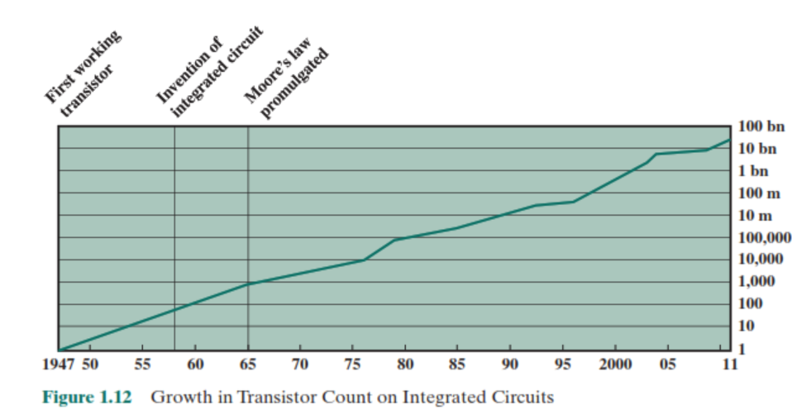
Moore’s Law
the number of transistors that could
be put on a single chip was doubling every year
Konsekuensinya?
Silahkan dicari ☺
Refer ke textbook hal 21-22

Slide 23
Later Generations
less general agreement on defining generations of computers
Two application:
semiconductor memory
Microprocessors: all of the components of a CPU on a single chip
Intel 4004

Slide 24
Performa Komputer

Slide 25
Aplikasi
■ Image processing
■ Three-dimensional rendering
■ Speech recognition
■ Videoconferencing
■ Multimedia authoring
■ Voice and video annotation of files
■ Simulation modeling

Slide 26
Microprocessor speed
Microprocessor: based on DRAM
Meningkat sesuai dengan moore’s law
Tapi tidak cukup
Teknik untuk mempercepat Microprocessor:
Pipelining
Branch prediction
Superscalar execution
Data flow analysi
Speculative execution

Slide 27
three approaches to achieving increased processor speed
Increase the hardware speed of the processor
Increase the size and speed of caches that are interposed between the processor and main memory
Make changes to the processor organization and architecture that increase the effective speed of instruction execution. Typically, this involves using parallelism in one form or another.

Slide 28
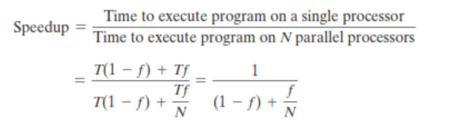
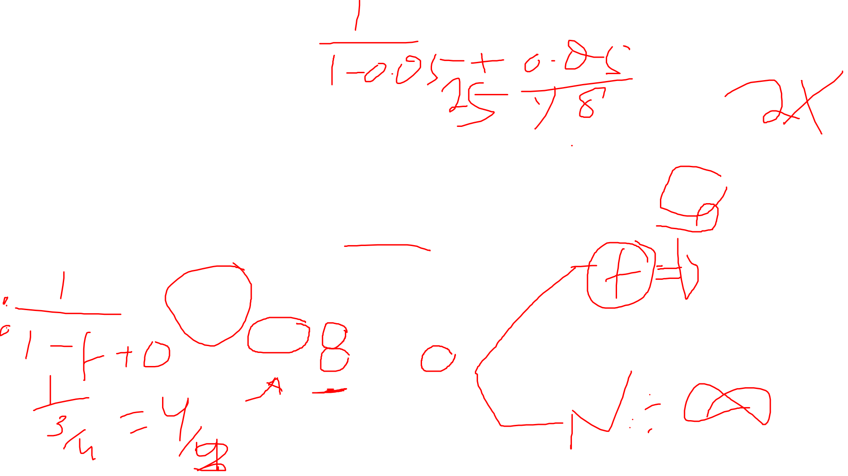
Amdahl’s Law
proposed by Gene Amdahl in 1967
Deals with the potential speedup of a program using multiple processors compared to a single processor
Consider a program running on a single processor such that a fraction (1 - f) of the execution time involves code that is inherently sequential, and a fraction f that involves code that is infinitely parallelizable with no scheduling overhead

Slide 29
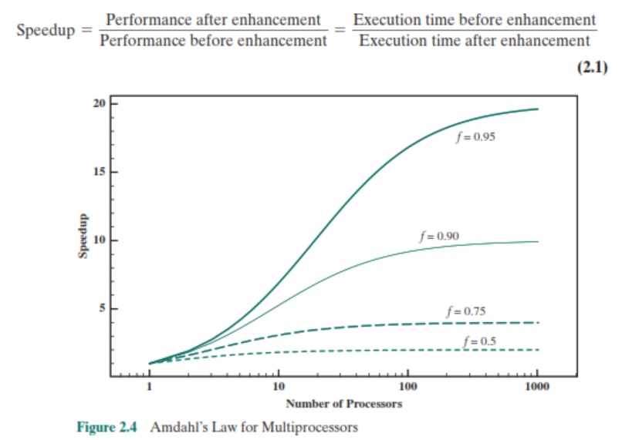


Slide 30
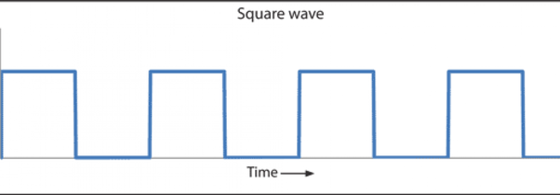
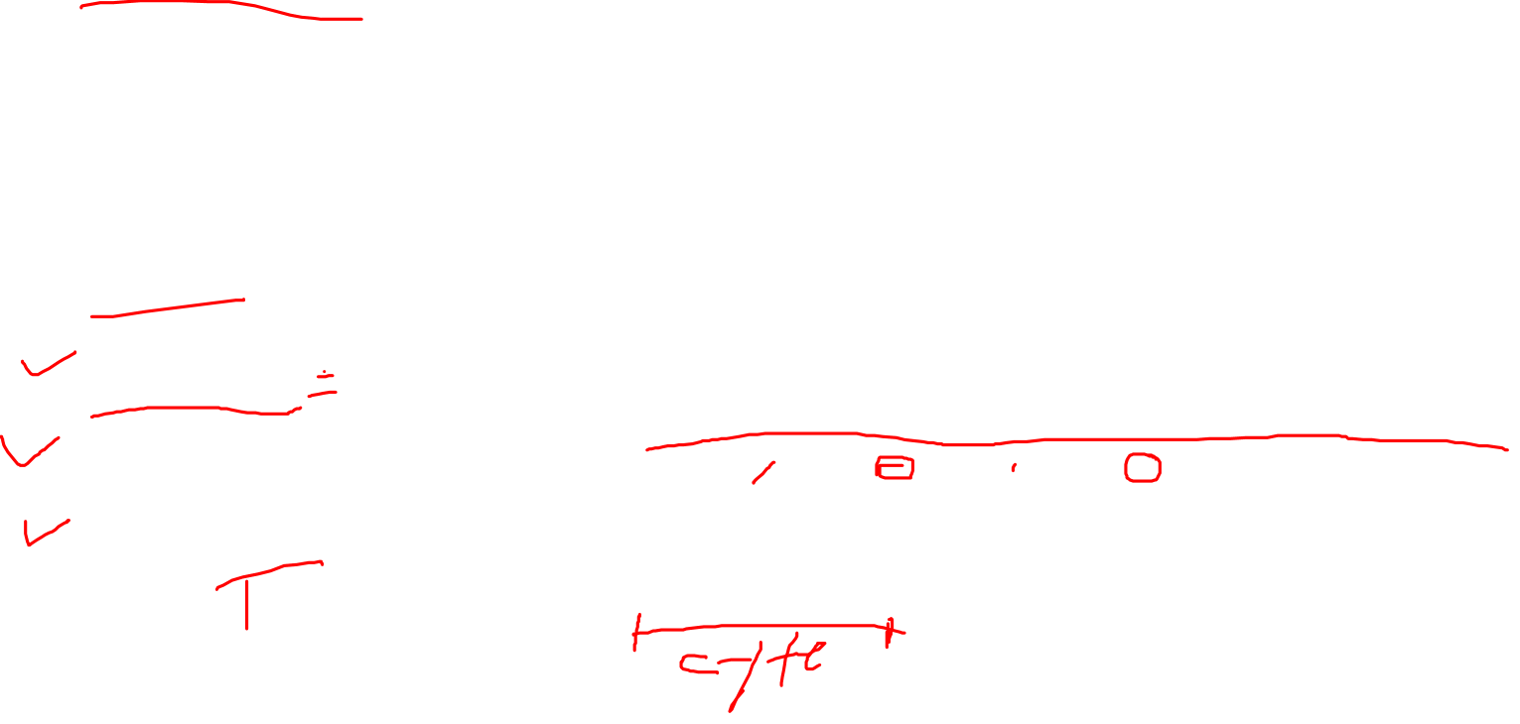
Basic measures of computer Performance
Clock Speed
Operasi pada prosesor diatur dengan menggunakan system clock
Kecepatan processor ditentukan oleh frekuensi pulse dari system clock, diukur dalam cycles per second atau Hz
1-GHz processor =>1 billion pulses per second
Clock rate
Clock Cycle
Cycle time

Slide 31
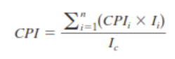
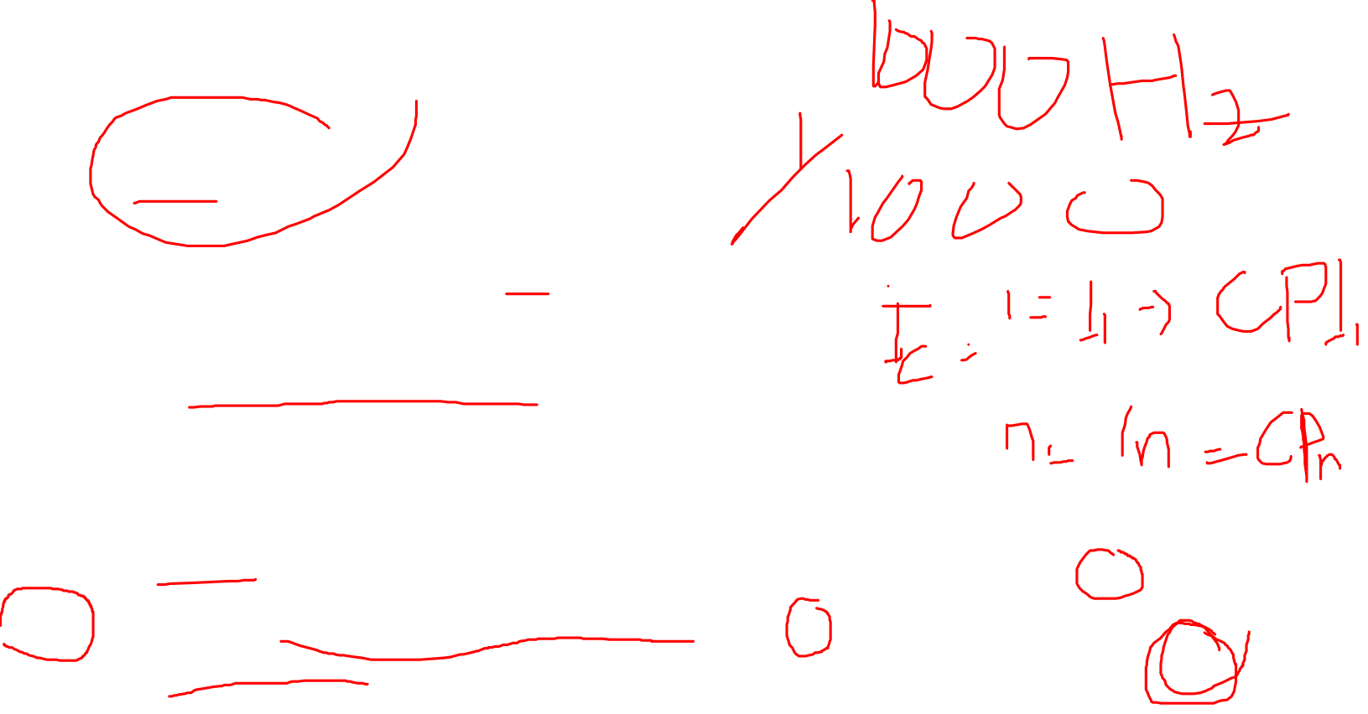
Instruction Execution Rate
cycle time τ =1/f
instruction count sebuah program I_{c}
I_{c} = Jumlah machine instruction yang dieksekusi oleh program sampai selesai
number of instruction executions, not the number of instructions in the object code of the program
average cycles per instruction (CPI) untuk sebuah program
CPI_{i} => jumlah cycles diperlukan untuk jenis instruksi I
I_{i} => jumlah instruksi tipe I yang dieksekusi untuk sebuah program, maka

Slide 32
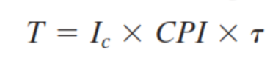
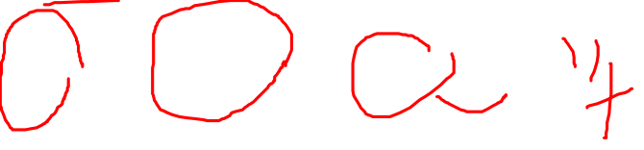
Instruction Execution Rate-2
Processor time T: waktu untuk eksekusi sebuah program

Slide 33
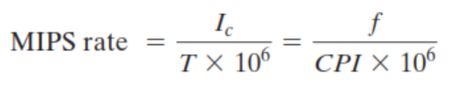
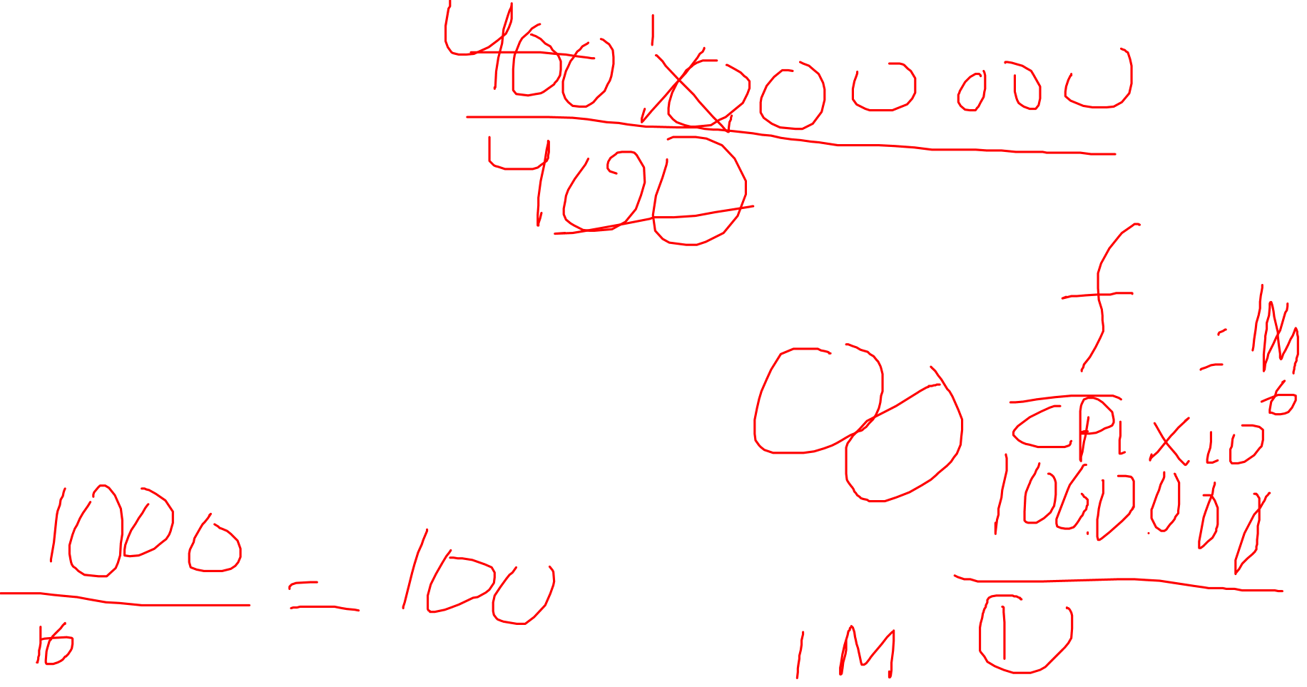
MIPS rate
A common measure of performance for a processor is the rate at which instructions are executed, expressed as millions of instructions per second (MIPS), referred to as the MIPS rate

Slide 34
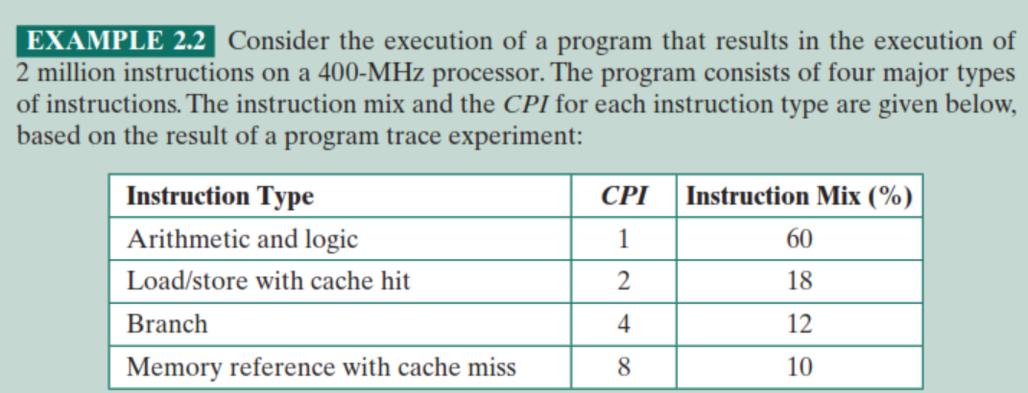
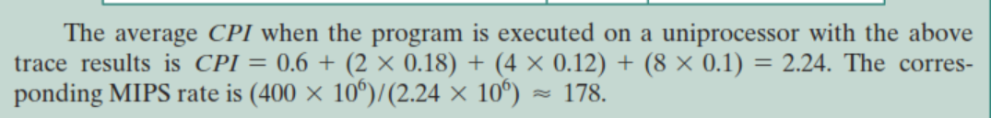
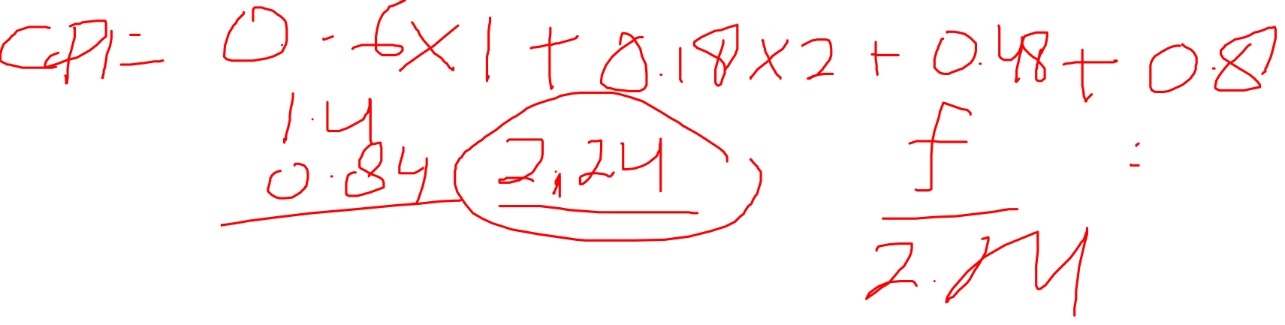
Contoh

Slide 35
Latihan
Perbedaan organisasi dan arsitektur computer, beri contoh
Apa fungsi dasar computer
Sebutkan struktru utama dari computer
Apa struktur utama dari CPU
Apakah multicore ?
Apakah beda CPU, core dan processor
Sebutkan perbedaan utama computer antar generasi
Apa beda integrated circuit dan microprocessor
Apa bunyi moore’s law? Apa konsekuensinya?
Sesuai dengan amdahls law, speedup factor tergantung pada apa saja?
Jelaskan konsekuensi dari amdahls law
Apa cycle time itu
Apa cycle rate itu
Apa CPI?
Apakah MIPS rate itu?

Slide 36
